Slide 1

Lecture 4: Parallel Tools Landscape – Part 1
Allen D. Malony
Department of Computer and Information Science

Slide 2
Short Course Outline
Lecture 1: Introduction and Fundamentals
Lecture 2: Methodology
Lecture 3: Tools Technology
Lecture 4: Tools Landscape – Part 1
Lecture 5: Tools Landscape – Part 2
Lecture 6: TAU Performance System
Lecture 7: TAU Applications
Lecture 8: Advances in TAU
Lecture 9: Future Directions
Tuesday
Wednesday
Thursday

Slide 3
Performance and Debugging Tools
Performance Measurement and Analysis:
Open|SpeedShop
HPCToolkit
Vampir
Scalasca
Periscope
mpiP
Paraver
PerfExpert
TAU
Modeling and prediction
Prophesy
MuMMI
Debugging
Stat
Autotuning Frameworks
Active Harmony

Slide 4
Performance Tools Matrix
TOOL | Profiling | Tracing | Instrumentation | Sampling
Scalasca | X | X | X | X
HPCToolkit | X | X |  | X
Vampir |  | X | X
Open|SpeedShop | X | X | X | X
Periscope | X |  | X
mpiP | X | X | X
Paraver |  | X | X | X
TAU | X | X | X | X

Slide 5

Open|SpeedShop
Krell Institute (USA)
http://www.openspeedshop.org

Slide 6
Open|SpeedShop Tool Set
Open Source Performance Analysis Tool Framework
Most common performance analysis steps all in one tool
Combines tracing and sampling techniques
Extensible by plugins for data collection and representation
Gathers and displays several types of performance information
Flexible and Easy to use
User access through: GUI, Command Line, Python Scripting, convenience scripts
Scalable Data Collection
Instrumentation of unmodified application binaries
New option for hierarchical online data aggregation
Supports a wide range of systems
Extensively used and tested on a variety of Linux clusters
Cray XT/XE/XK and Blue Gene L/P/Q support

Slide 7
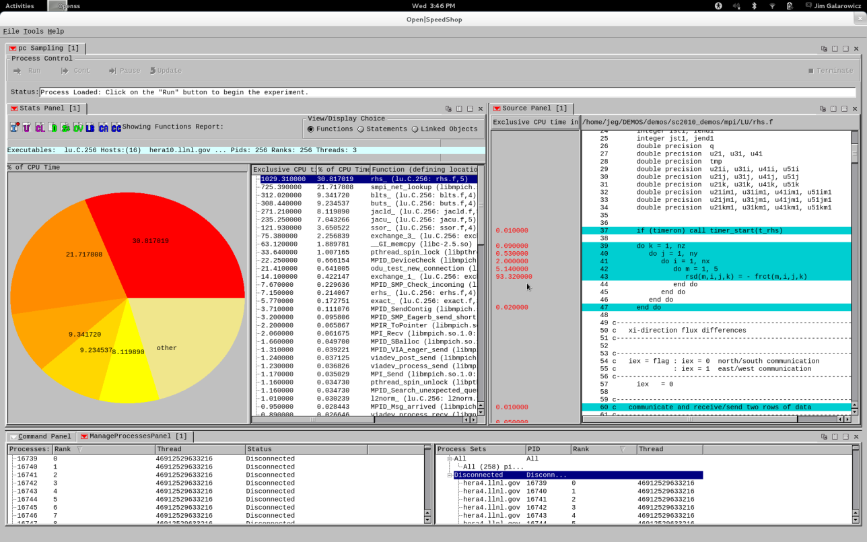
Open|SpeedShop Workflow
srun –n4 –N1 smg2000 –n 65 65 65
osspcsamp “srun –n4 –N1 smg2000 –n 65 65 65”
MPI Application
O|SS
Post-mortem

Slide 8
Alternative Interfaces
Experiment Commands
expAttach
expCreate
expDetach
expGo
expView
List Commands
list –v exp
list –v hosts
list –v src
Session Commands
setBreak
openGui
Scripting language
Immediate command interface
O|SS interactive command line
(CLI)
Python module
import openss
my_filename=openss.FileList("myprog.a.out")
my_exptype=openss.ExpTypeList("pcsamp")
my_id=openss.expCreate(my_filename,my_exptype)
openss.expGo()
My_metric_list = openss.MetricList("exclusive")
my_viewtype = openss.ViewTypeList("pcsamp”)
result = openss.expView(my_id,my_viewtype,my_metric_list)

Slide 9
Central Concept: Experiments
Users pick experiments:
What to measure and from which sources?
How to select, view, and analyze the resulting data?
Two main classes:
Statistical Sampling
periodically interrupt execution and record location
useful to get an overview
low and uniform overhead
Event Tracing (DyninstAPI)
gather and store individual application events
provides detailed per event information
can lead to huge data volumes
O|SS can be extended with additional experiments

Slide 10
Sampling Experiments in O|SS
PC Sampling (pcsamp)
Record PC repeatedly at user defined time interval
Low overhead overview of time distribution
Good first step, lightweight overview
Callpath Profiling (usertime)
PC sampling and call stacks for each sample
Provides inclusive and exclusive timing data
Use to find hot call paths, whom is calling who
Hardware Counters (hwc, hwctime, hwcsamp)
Access to data like cache and TLB misses
hwc, hwctime:
sample a HWC event based on an event threshold
default event is PAPI_TOT_CYC overflows
hwcsamp:
periodically sample up to 6 counter events based (hwcsamp)
default events are PAPI_FP_OPS and PAPI_TOT_CYC

Slide 11
Tracing Experiments in O|SS
Input/Output Tracing (io, iop, iot)
Record invocation of all POSIX I/O events
Provides aggregate and individual timings
Lightweight I/O profiling (iop)
Store function arguments and return code for each call (iot)
MPI Tracing (mpi, mpit, mpiotf)
Record invocation of all MPI routines
Provides aggregate and individual timings
Store function arguments and return code for each call (mpit)
Create Open Trace Format (OTF) output (mpiotf)
Floating Point Exception Tracing (fpe)
Triggered by any FPE caused by the application
Helps pinpoint numerical problem areas

Slide 12
Performance Analysis in Parallel
How to deal with concurrency?
Any experiment can be applied to parallel application
Important step: aggregation or selection of data
Special experiments targeting parallelism/synchronization
O|SS supports MPI and threaded codes
Automatically applied to all tasks/threads
Default views aggregate across all tasks/threads
Data from individual tasks/threads available
Thread support (incl. OpenMP) based on POSIX threads
Specific parallel experiments (e.g., MPI)
Wraps MPI calls and reports
MPI routine time
MPI routine parameter information
The mpit experiment also store function arguments and return code for each call

Slide 13
How to Run a First Experiment in O|SS?
Picking the experiment
What do I want to measure?
We will start with pcsamp to get a first overview
Launching the application
How do I control my application under O|SS?
Enclose how you normally run your application in quotes
osspcsamp “mpirun –np 256 smg2000 –n 65 65 65”
Storing the results
O|SS will create a database
Name: smg2000-pcsamp.openss
Exploring the gathered data
How do I interpret the data?
O|SS will print a default report
Open the GUI to analyze data in detail (run: “openss”)

Slide 14
Example Run with Output
osspcsamp “mpirun –np 2 smg2000 –n 65 65 65” (1/2)
Bash> osspcsamp "mpirun -np 2 ./smg2000 -n 65 65 65"
[openss]: pcsamp experiment using the pcsamp experiment default sampling rate: "100".
[openss]: Using OPENSS_PREFIX installed in /opt/OSS-mrnet
[openss]: Setting up offline raw data directory in /tmp/jeg/offline-oss
[openss]: Running offline pcsamp experiment using the command:
"mpirun -np 2 /opt/OSS-mrnet/bin/ossrun "./smg2000 -n 65 65 65" pcsamp"
Running with these driver parameters:
(nx, ny, nz) = (65, 65, 65)
…
<SMG native output>
…
Final Relative Residual Norm = 1.774415e-07
[openss]: Converting raw data from /tmp/jeg/offline-oss into temp file X.0.openss
Processing raw data for smg2000
Processing processes and threads ...
Processing performance data ...
Processing functions and statements ...

Slide 15
Example Run with Output
osspcsamp “mpirun –np 2 smg2000 –n 65 65 65” (2/2)
[openss]: Restoring and displaying default view for:
/home/jeg/DEMOS/demos/mpi/openmpi-1.4.2/smg2000/test/smg2000-pcsamp-1.openss
[openss]: The restored experiment identifier is: -x 1
Exclusive CPU time % of CPU Time Function (defining location)
in seconds.
3.630000000 43.060498221 hypre_SMGResidual (smg2000: smg_residual.c,152)
2.860000000 33.926453144 hypre_CyclicReduction (smg2000: cyclic_reduction.c,757)
0.280000000 3.321470937 hypre_SemiRestrict (smg2000: semi_restrict.c,125)
0.210000000 2.491103203 hypre_SemiInterp (smg2000: semi_interp.c,126)
0.150000000 1.779359431 opal_progress (libopen-pal.so.0.0.0)
0.100000000 1.186239620 mca_btl_sm_component_progress (libmpi.so.0.0.2)
0.090000000 1.067615658 hypre_SMGAxpy (smg2000: smg_axpy.c,27)
0.080000000 0.948991696 ompi_generic_simple_pack (libmpi.so.0.0.2)
0.070000000 0.830367734 __GI_memcpy (libc-2.10.2.so)
0.070000000 0.830367734 hypre_StructVectorSetConstantValues (smg2000: struct_vector.c,537)
0.060000000 0.711743772 hypre_SMG3BuildRAPSym (smg2000: smg3_setup_rap.c,233)
View with GUI: openss –f smg2000-pcsamp-1.openss

Slide 16
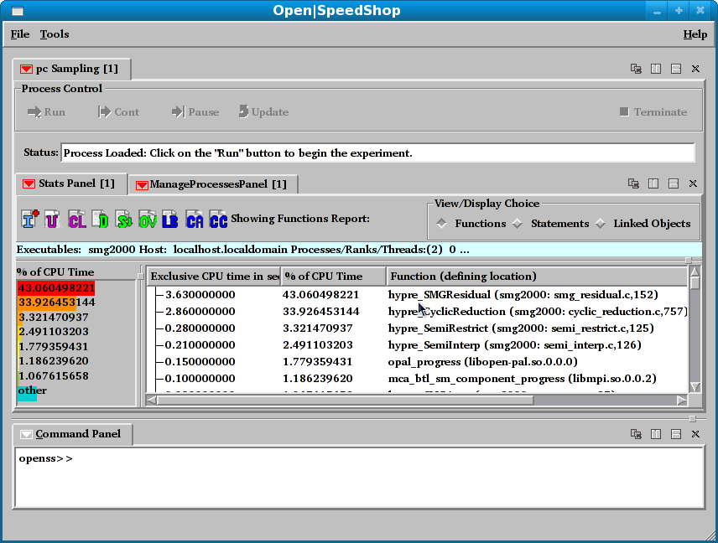
Default Output Report View
Performance Data
Default view: by Function
(Data is sum from all processes and threads)
Select “Functions”, click D-icon
Toolbar to switch
Views
Graphical Representation

Slide 17
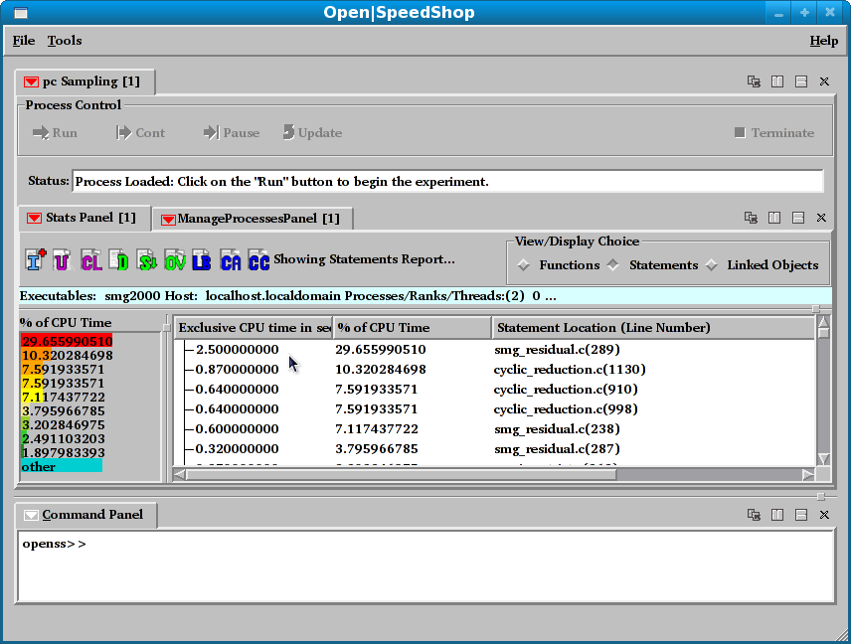
Statement Report Output View
Performance Data
View Choice: Statements
Select “statements, click D-icon
Statement in Program that took the most time

Slide 18
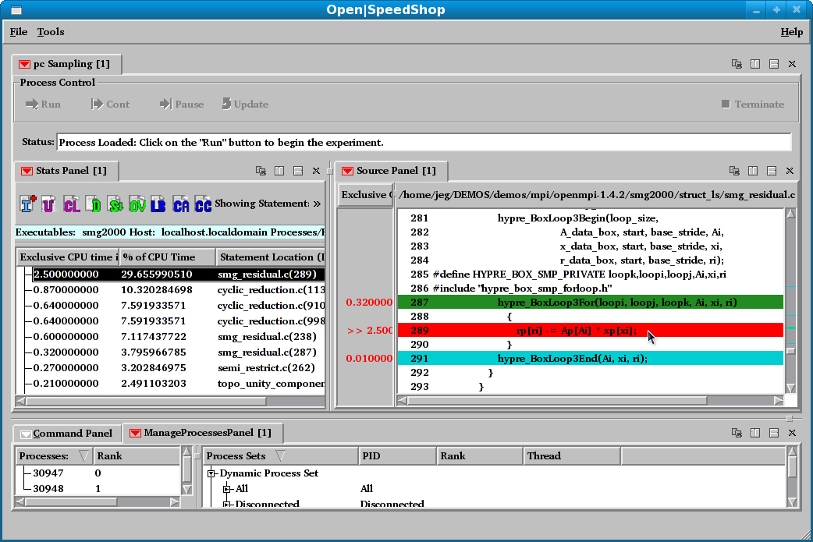
Associate Source & Performance Data
Double click to open source window
Use window controls to split/arrange windows
Selected performance
data point

Slide 19
Open|SpeedShop Summary
Place the way you run your application normally in quotes and pass it as an argument to osspcsamp, or any of the other experiment convenience scripts: ossio, ossmpi, etc.
osspcsamp “srun –N 8 –n 64 ./mpi_application app_args”
Open|SpeedShop sends a summary profile to stdout
Open|SpeedShop creates a database file
Display alternative views of the data with the GUI via:
openss –f <database file>
Display alternative views of the data with the CLI via:
openss –cli –f <database file>
On clusters, need to set OPENSS_RAWDATA_DIR
Should point to a directory in a shared file system
More on this later – usually done in a module or dotkit file.
Start with pcsamp for overview of performance
Then look into performance issues with other experiments

Slide 20

HPCToolkit
John Mellor-Crummey
Rice University (USA)
http://hpctoolkit.org

Slide 21
HPCToolkit
Integrated suite of tools for measurement and analysis of program performance
Works with multilingual, fully optimized applications that are statically or dynamically linked
Sampling-based measurement methodology
Serial, multiprocess, multithread applications

Slide 22
HPCToolkit
Performance Analysis through callpath sampling
Designed for low overhead
Hot path analysis
Recovery of program structure from binary
Image by John Mellor-Crummey

Slide 23
HPCToolkit DESIGN PRINCIPLES
Employ binary-level measurement and analysis
observe fully optimized, dynamically linked executions
support multi-lingual codes with external binary-only libraries
Use sampling-based measurement (avoid instrumentation)
controllable overhead
minimize systematic error and avoid blind spots
enable data collection for large-scale parallelism
Collect and correlate multiple derived performance metrics
diagnosis typically requires more than one species of metric
Associate metrics with both static and dynamic context
loop nests, procedures, inlined code, calling context
Support top-down performance analysis
natural approach that minimizes burden on developers
Notes:
language independence: work with application binaries rather than application source code
instrumentation: use statistical sampling instead of instrumentation.
context: support call path profiling by unwinding call stacks
myopia: no one metric suffices for diagnosing problems; only the relationship between metrics (e.g. cycles and FLOPS) can diagnose problems
derived metrics: raw metrics can tell you where you are spending your time; derived metrics can tell you where you are underutilizing memory bandwidth, or functional units
top down: with large programs, can’t afford to hunt for problems. you must be directed to them in a top-down manner
event aggregation: even if counter’s don’t trigger on the right line, attribution for loops can still be accurate. loops matter more than individual lines since only the aggregate properties of all of the lines in a loop matter

Slide 24
HPCToolkit Workflow
profile execution
[hpcrun]
call stack profile
compile & link
app. source
optimized
binary
binary analysis
[hpcstruct]
program structure
presentation
[hpcviewer/
hpctraceviewer]
interpret profile
correlate w/ source
[hpcprof/hpcprof-mpi]
database

Slide 25
HPCToolkit Workflow
profile execution
[hpcrun]
call stack profile
compile & link
app. source
optimized
binary
binary analysis
[hpcstruct]
program structure
For dynamically-linked executables on stock Linux
compile and link as you usually do: nothing special needed
For statically-linked executables (e.g. for Blue Gene, Cray)
add monitoring by using hpclink as prefix to your link line
uses “linker wrapping” to catch “control” operations
process and thread creation, finalization, signals, ...
presentation
[hpcviewer/
hpctraceviewer]
interpret profile
correlate w/ source
[hpcprof/hpcprof-mpi]
database

Slide 26
HPCToolkit Workflow
profile execution
[hpcrun]
call stack profile
compile & link
app. source
optimized
binary
binary analysis
[hpcstruct]
program structure
Measure execution unobtrusively
launch optimized application binaries
dynamically-linked applications: launch with hpcrun to measure
statically-linked applications: measurement library added at link time
control with environment variable settings
collect statistical call path profiles of events of interest
presentation
[hpcviewer/
hpctraceviewer]
interpret profile
correlate w/ source
[hpcprof/hpcprof-mpi]
database

Slide 27
HPCToolkit Workflow
profile execution
[hpcrun]
call stack profile
compile & link
app. source
optimized
binary
binary analysis
[hpcstruct]
program structure
Analyze binary with hpcstruct: recover program structure
analyze machine code, line map, debugging information
extract loop nesting & identify inlined procedures
map transformed loops and procedures to source
presentation
[hpcviewer/
hpctraceviewer]
interpret profile
correlate w/ source
[hpcprof/hpcprof-mpi]
database

Slide 28
HPCToolkit Workflow
profile execution
[hpcrun]
call stack profile
compile & link
app. source
optimized
binary
binary analysis
[hpcstruct]
program structure
Combine multiple profiles
multiple threads; multiple processes; multiple executions
Correlate metrics to static & dynamic program structure
presentation
[hpcviewer/
hpctraceviewer]
interpret profile
correlate w/ source
[hpcprof/hpcprof-mpi]
database

Slide 29
HPCToolkit Workflow
profile execution
[hpcrun]
call stack profile
compile & link
app. source
optimized
binary
binary analysis
[hpcstruct]
program structure
Presentation
explore performance data from multiple perspectives
rank order by metrics to focus on what’s important
compute derived metrics to help gain insight
e.g. scalability losses, waste, CPI, bandwidth
graph thread-level metrics for contexts
explore evolution of behavior over time
presentation
[hpcviewer/
hpctraceviewer]
interpret profile
correlate w/ source
[hpcprof/hpcprof-mpi]
database

Slide 30
Analyzing results with hpcviewer
associated
source code
Callpath to
hotspot
Image by John Mellor-Crummey

Slide 31
Principal Views
Calling context tree view - “top-down” (down the call chain)
Associate metrics with each dynamic calling context
High-level, hierarchical view of distribution of costs
Example: quantify initialization, solve, post-processing
Caller’s view - “bottom-up” (up the call chain)
Apportion a procedure’s metrics to its dynamic calling contexts
Understand costs of a procedure called in many places
Example: see where PGAS put traffic is originating
Flat view - ignores the calling context of each sample point
Aggregate all metrics for a procedure, from any context
Attribute costs to loop nests and lines within a procedure
Example: assess the overall memory hierarchy performance within a critical procedure
Notes:
calling context view and caller’s view ONLY AVAILABLE for call path profiles
flat view available for both flat profiles and calling context profiles

Slide 32
Using HPCToolkit
Add hpctoolkit’s bin directory to your path
Adjust your compiler flags for your application
Add –g to retain line map information
Decide what hardware counters to monitor
Profile execution:
Produces one .hpcrun results file per thread
Recover program structure
hpcstruct <command>
Produces one .hpcstruct file containing the loop structure of the binary
Interpret profile / correlate measurements with source code
hpcprof [–S <hpcstruct_file>] [-M thread] [–o <output_db_name>] <hpcrun_files>
Creates performance database
Use hpcviewer to visualize the performance database

Slide 33

Vampir
Wolfgang Nagel
ZIH, Technische Universität Dresden (Germany)
http://www.vampir.eu

Slide 34
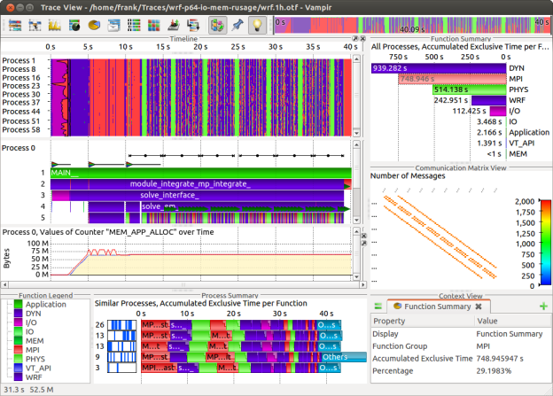
Mission
Visualization of dynamics of complex parallel processes
Requires two components
Monitor/Collector (Score-P)
Charts/Browser (Vampir)
Typical questions that Vampir helps to answer:
What happens in my application execution during a given time in a given process or thread?
How do the communication patterns of my application execute on a real system?
Are there any imbalances in computation, I/O or memory usage and how do they affect the parallel execution of my application?

Slide 35
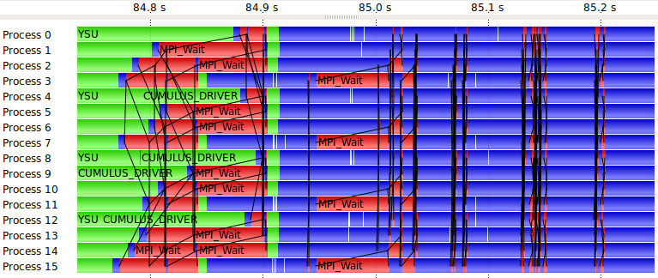
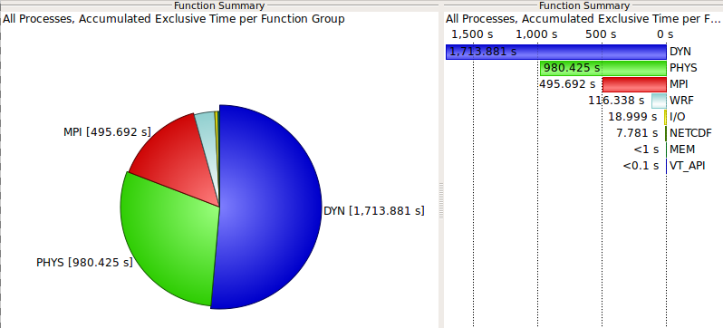
Event Trace Visualization with Vampir
Alternative and supplement to automatic analysis
Show dynamic run-time behavior graphically at any level of detail
Provide statistics and performance metrics
Timeline charts
Show application activities and communication along a time axis
Summary charts
Provide quantitative results for the currently selected time interval

Slide 36
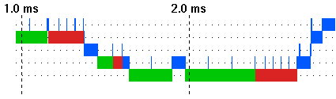
Vampir – Visualization Modes (1)
Directly on front end or local machine
% vampir
CPU
CPU
CPU
CPU
Score-P
Trace
File (OTF2)
Vampir 8
Multi-Core
Program
CPU
CPU
CPU
CPU
Small/Medium sized trace
Thread parallel

Slide 37
Vampir – Visualization Modes (2)
On local machine with remote VampirServer
% vampirserver start –n 12
% vampir
VampirServer
Vampir 8
Score-P
CPU
CPU
CPU
CPU
LAN/WAN
CPU
CPU
CPU
CPU
Trace
File
(OTF2)
CPU
CPU
CPU
CPU
CPU
CPU
CPU
CPU
CPU
CPU
CPU
CPU
CPU
CPU
CPU
CPU
Large Trace File
(stays on remote machine)
Many-Core
Program
CPU
CPU
CPU
CPU
CPU
CPU
CPU
CPU
CPU
CPU
CPU
CPU
CPU
CPU
CPU
CPU
CPU
CPU
CPU
CPU
MPI parallel application
CPU
CPU
CPU
CPU

Slide 38
Vampir Performance Analysis Toolset: Usage
Instrument your application with Score-P
Run your application with an appropriate test set
Analyze your trace file with Vampir
Small trace files can be analyzed on your local workstation
Start your local Vampir
Load trace file from your local disk
Large trace files should be stored on the HPC file system
Start VampirServer on your HPC system
Start your local Vampir
Connect local Vampir with the VampirServer on the HPC system
Load trace file from the HPC file system

Slide 39








Main Displays of Vampir
Timeline Charts:
Master Timeline
Process Timeline
Counter Data Timeline
Performance Radar
Summary Charts:
Function Summary
Message Summary
Process Summary
Communication Matrix View

Slide 40
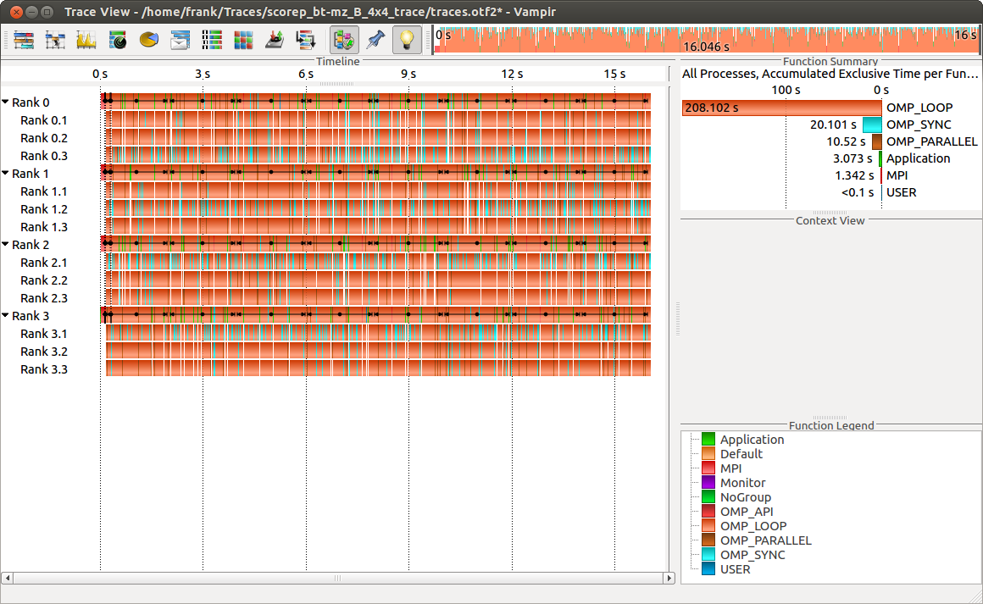
Visualization of the NPB-MZ-MPI / BT trace
% vampir scorep_bt-mz_B_4x4_trace
Navigation Toolbar
Function Summary
Function Legend
Master Timeline

Slide 41
Visualization of the NPB-MZ-MPI / BT trace
Master Timeline
Detailed information about functions, communication and synchronization events for collection of processes.

Slide 42
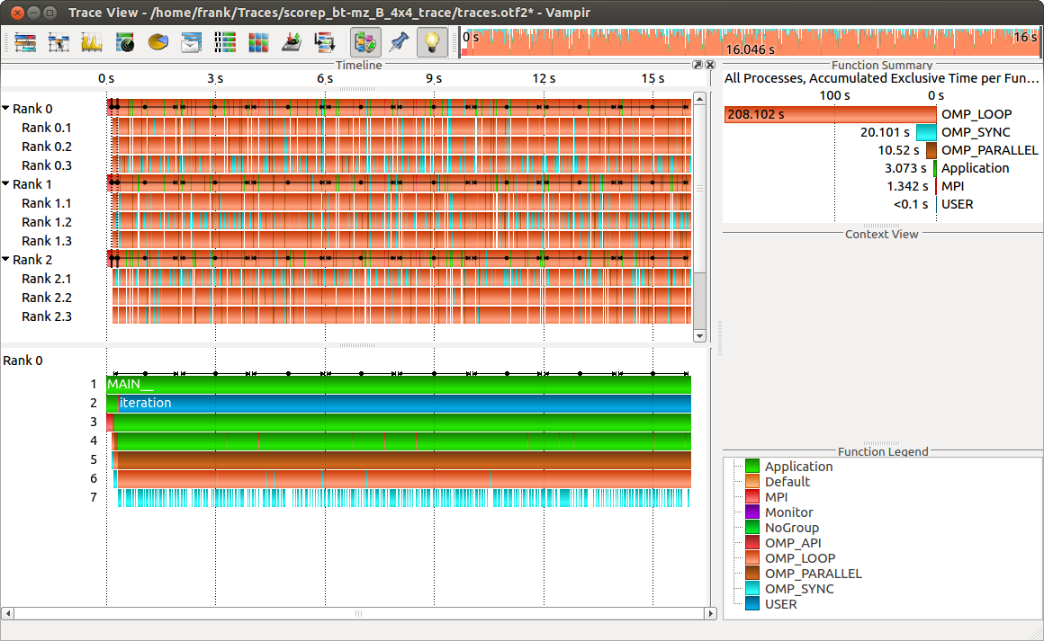
Visualization of the NPB-MZ-MPI / BT trace
Process Timeline
Detailed information about different levels of function calls in a stacked bar chart for an individual process.

Slide 43
Visualization of the NPB-MZ-MPI / BT trace
Typical program phases
Initialisation Phase
Computation Phase

Slide 44
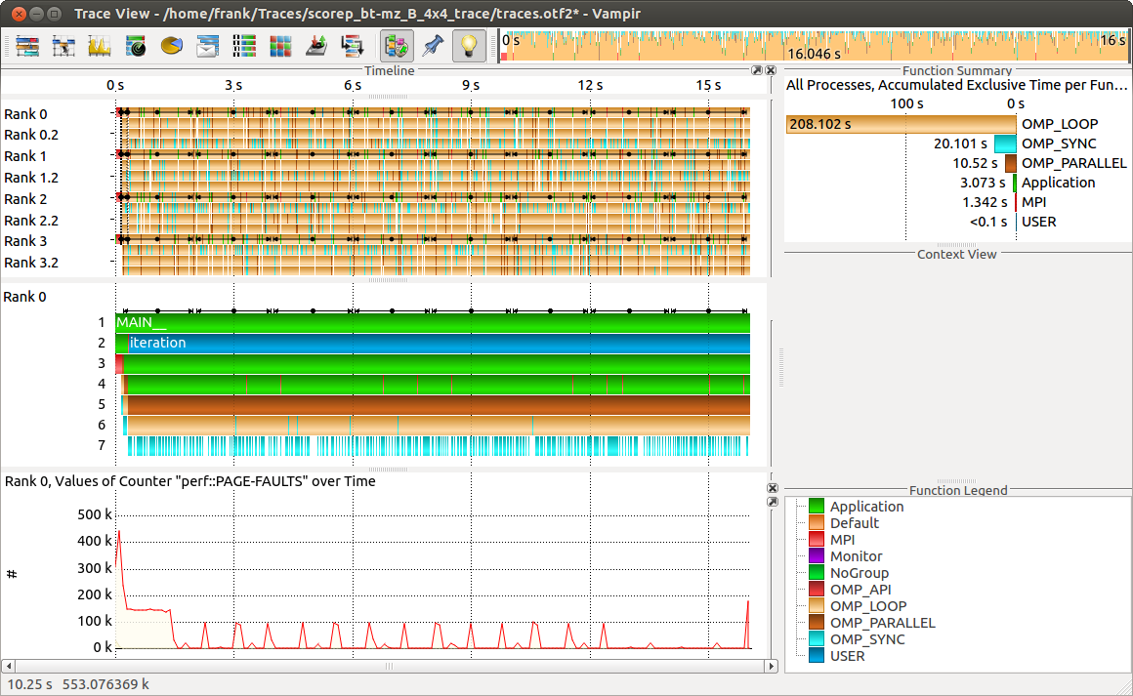
Visualization of the NPB-MZ-MPI / BT trace
Counter Data Timeline
Detailed counter information over time for an individual process.

Slide 45
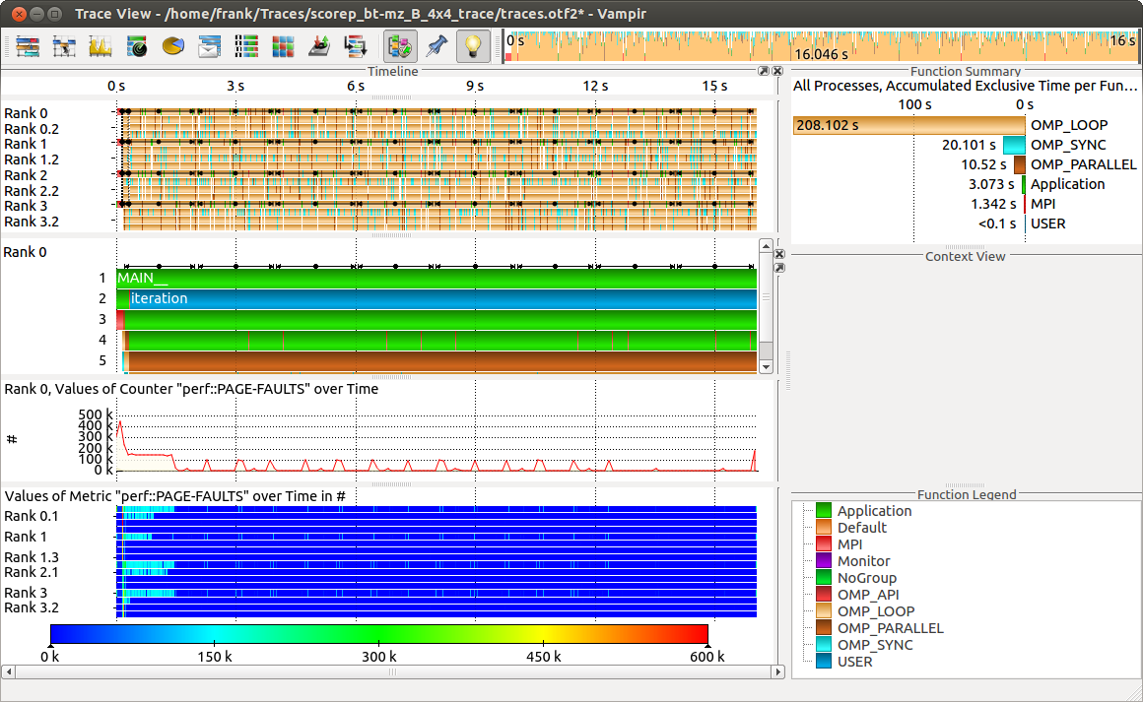
Visualization of the NPB-MZ-MPI / BT trace
Performance Radar
Detailed counter information over time for a collection of processes.

Slide 46
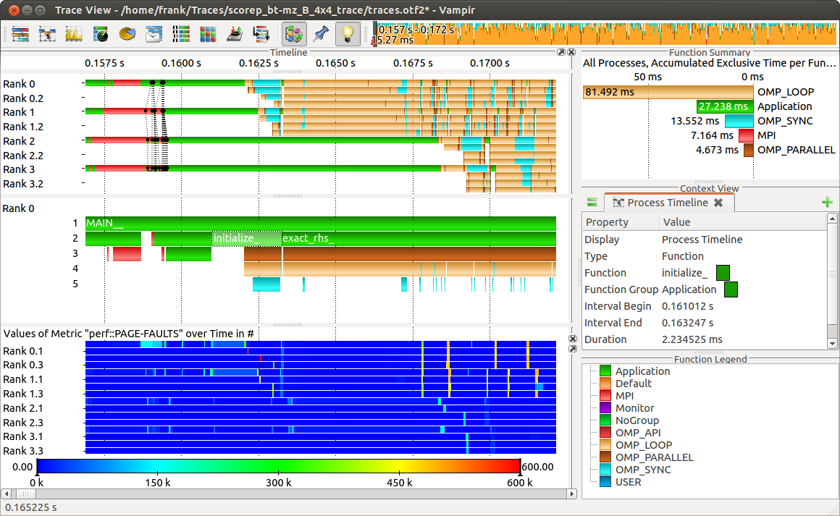
Visualization of the NPB-MZ-MPI / BT trace
Zoom in: Inititialisation Phase
Context View: Detailed information about function “initialize_”.

Slide 47
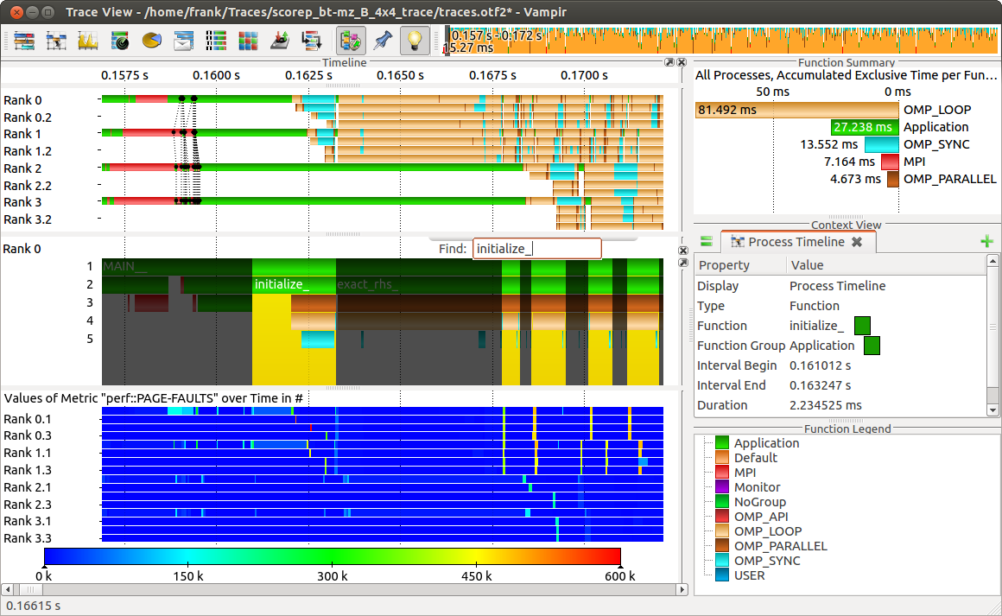
Visualization of the NPB-MZ-MPI / BT trace
Feature: Find Function
Execution of function “initialize_” results in higher page fault rates.

Slide 48
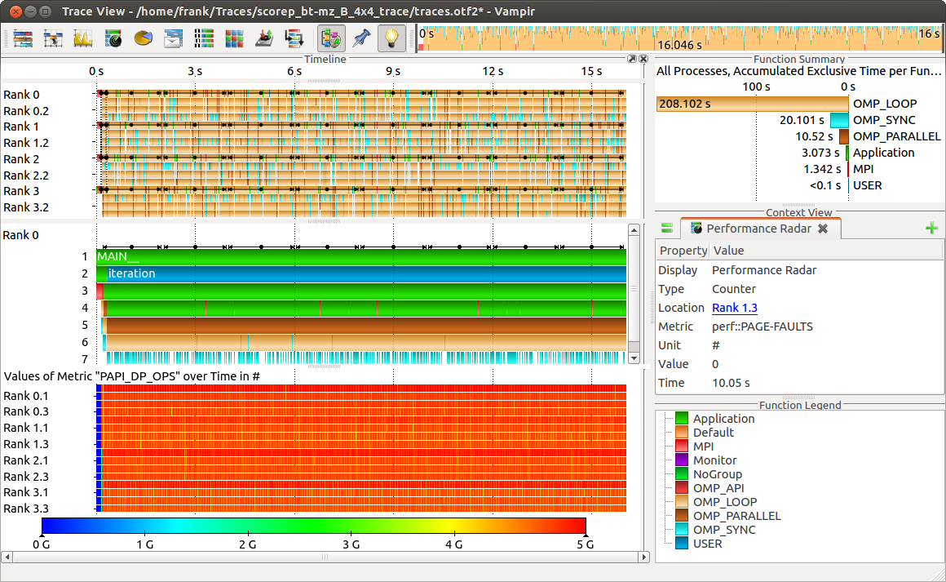
Visualization of the NPB-MZ-MPI / BT trace
Computation Phase
Computation phase results in higher floating point operations.

Slide 49
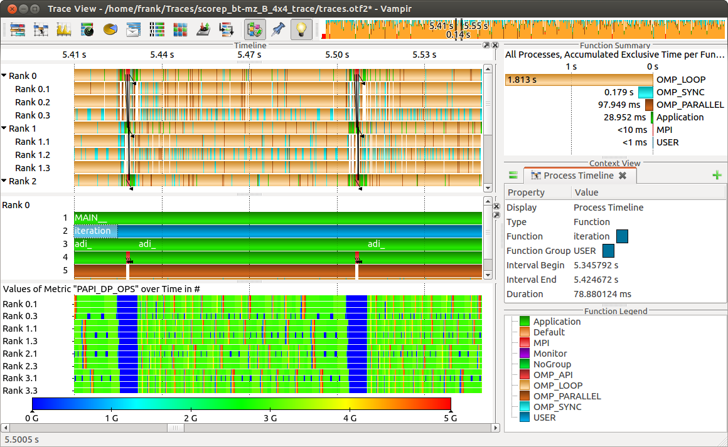
Visualization of the NPB-MZ-MPI / BT trace
Zoom in: Computation Phase
MPI communication results in lower floating point operations.

Slide 50
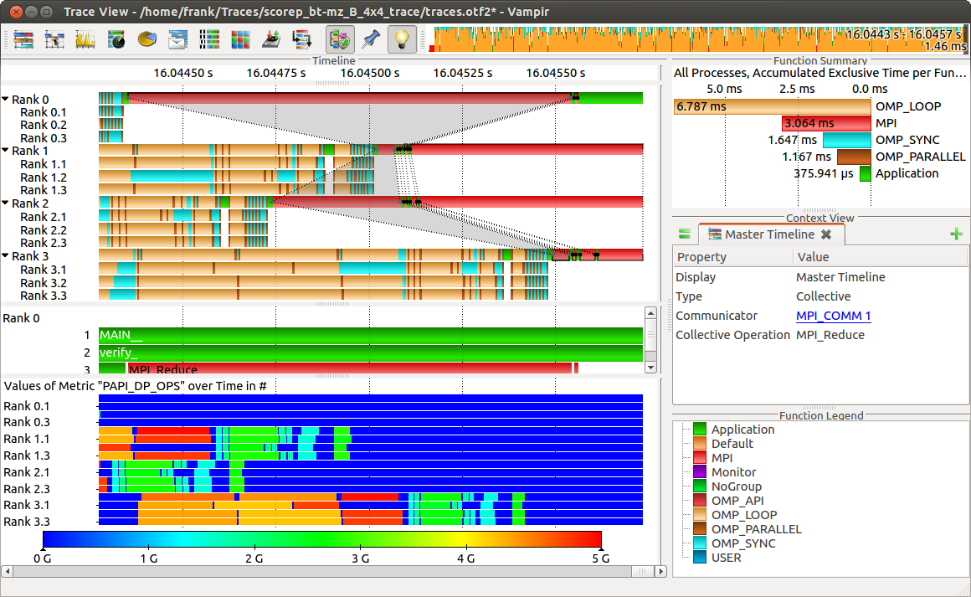
Visualization of the NPB-MZ-MPI / BT trace
Zoom in: Finalisation Phase
“Early reduce” bottleneck.

Slide 51
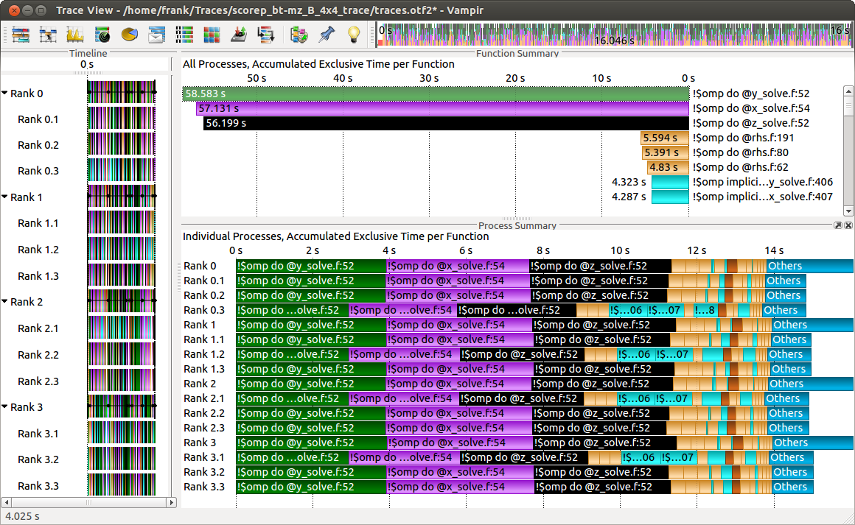
Visualization of the NPB-MZ-MPI / BT trace
Process Summary
Function Summary: Overview of the accumulated information across all functions and for a collection of processes.
Process Summary: Overview of the accumulated information across all functions and for every process independently.

Slide 52
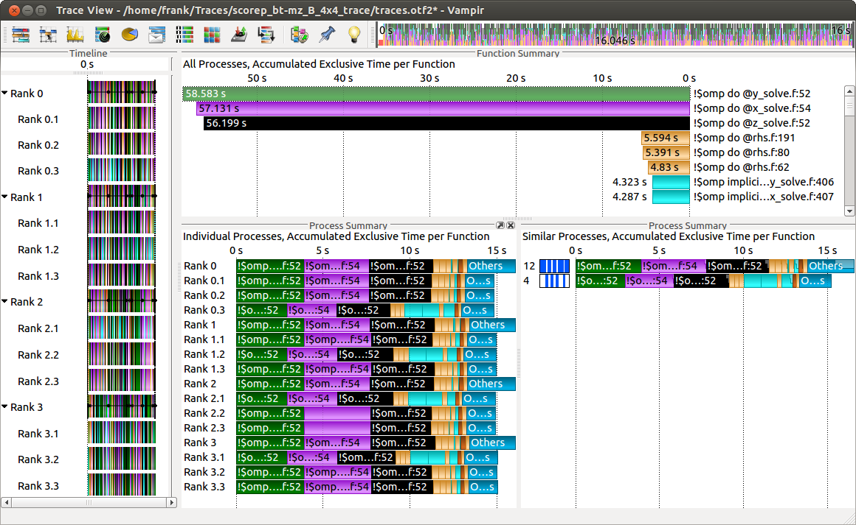
Visualization of the NPB-MZ-MPI / BT trace
Process Summary
Find groups of similar processes and threads by using summarized function information.

Slide 53
Vampir Summary
Vampir & VampirServer
Interactive trace visualization and analysis
Intuitive browsing and zooming
Scalable to large trace data sizes (20 TByte)
Scalable to high parallelism (200000 processes)
Vampir for Linux, Windows and Mac OS X
Vampir does neither solve your problems automatically nor point you directly at them
Rather it gives you FULL insight into the execution of your application

Slide 54

Scalasca
Bernd Mohr and Felix Wolf
Jülich Supercomputing Centre (Germany)
German Research School for Simulation Sciences
http://www.scalasca.org

Slide 55
Scalable parallel performance-analysis toolset
Focus on communication and synchronization
Integrated performance analysis process
Callpath profiling
performance overview on callpath level
Event tracing
in-depth study of application behavior
Supported programming models
MPI-1, MPI-2 one-sided communication
OpenMP (basic features)
Available for all major HPC platforms
Notes:
Source: Wolf/lmsu-supercomputing-academy-270612.pptx

Slide 56


Scalasca Project: Overview
Project started in 2006
Funded by Helmholtz Initiative and Networking Fund
Many research projects to present
Successor to pioneering KOJAK project (1998)
Automatic pattern-based trace analysis
Now joint development of
Jülich Supercomputing Centre
German Research School for Simulation Sciences

Slide 57
Scalasca Project: Objective
Development of a scalable performance analysis toolset for most popular parallel programming paradigms
Specifically targeting large-scale parallel applications
100,000 – 1,000,000 processes / thread
IBM BlueGene or Cray XT systems
Latest release:
Scalasca v2.0 with Score-P support (August 2013)

Slide 58
Scalasca: Automatic Trace Analysis
Idea
Automatic search for patterns of inefficient behavior
Classification of behavior and quantification of significance
Guaranteed to cover the entire event trace
Quicker than manual/visual trace analysis
Parallel replay analysis online
Low-level
event trace
Call
path
Analysis
High-level
result
≡
Property
Location
Notes:
Source: Mohr/vihps-scalasca.pptx

Slide 59
Scalasca 2.0 Features
Open source, New BSD license
Fairly portable
IBM Blue Gene, IBM SP and blade clusters, Cray XT, SGI Altix, Solaris & Linux clusters, ...
Uses Score-P instrumenter and measurement libraries
Scalasca 2.0 core package focuses on trace-based analyses
Supports common data formats
reads event traces in OTF2 format
writes analysis reports in CUBE4 format
Current limitations:
No support for nested OpenMP parallelism and tasking
Unable to handle OTF2 traces containing CUDA events

Slide 60
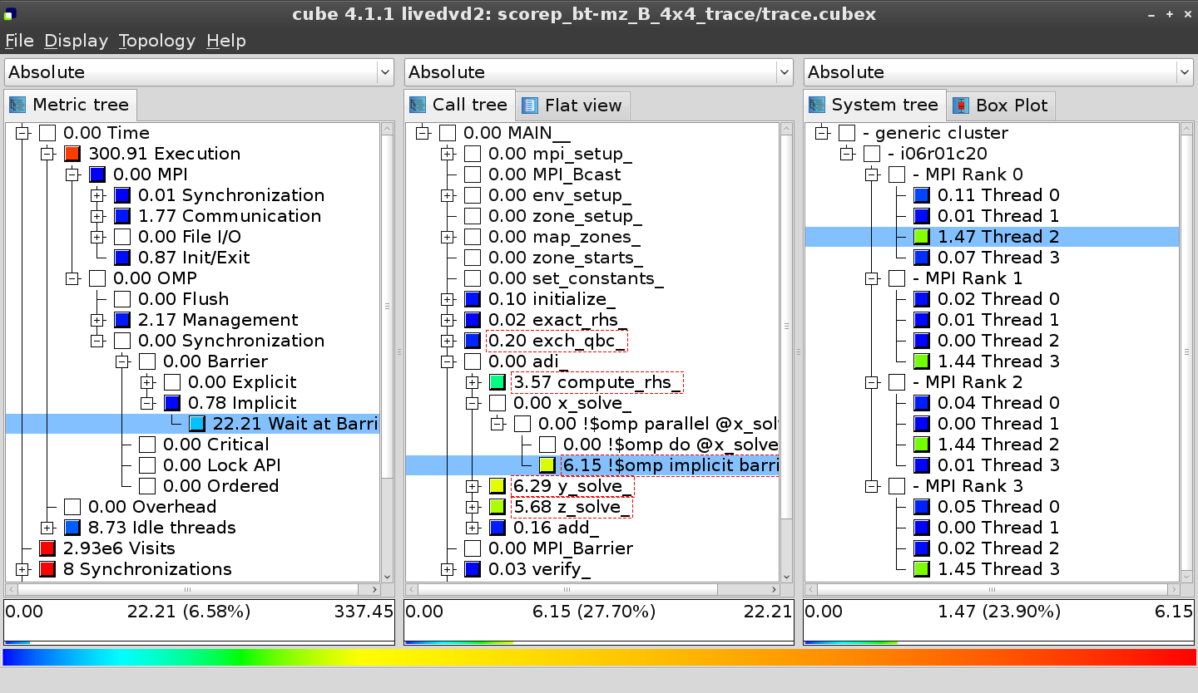
Scalasca Workflow
Measurement
library
Optimized measurement configuration
Summary report
Report manipulation
HWC
Local event traces
Parallel wait-state search
Instr.
target
application
Wait-state report
Scalasca trace analysis
Instrumented executable
Which problem?
Where in the program?
Which process?
Instrumenter compiler / linker
Source modules

Slide 61
Wait-state Analysis
Classification
Quantification
process
(a) Late Sender
time
process
time
(b) Late Sender / Wrong Order
process
time
(c) Late Receiver

Slide 62
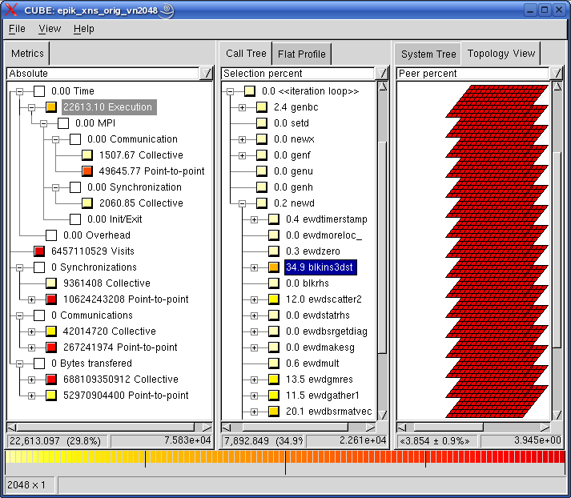
Callpath Profile: Computation
Execution
time excl.
MPI comm
Just 30% of simulation
Widely
spread
in code
Widely
spread
in code
Widely
spread
in code

Slide 63
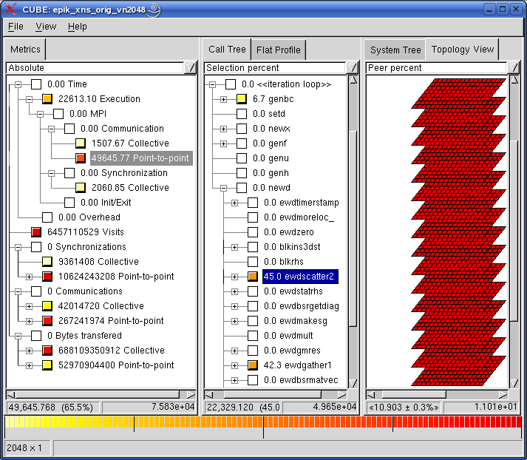
Callpath Profile: P2P Messaging
MPI point-
to-point
communic-
ation time
P2P comm 66% of simulation
Primarily
in scatter
& gather
Primarily
in scatter
& gather

Slide 64
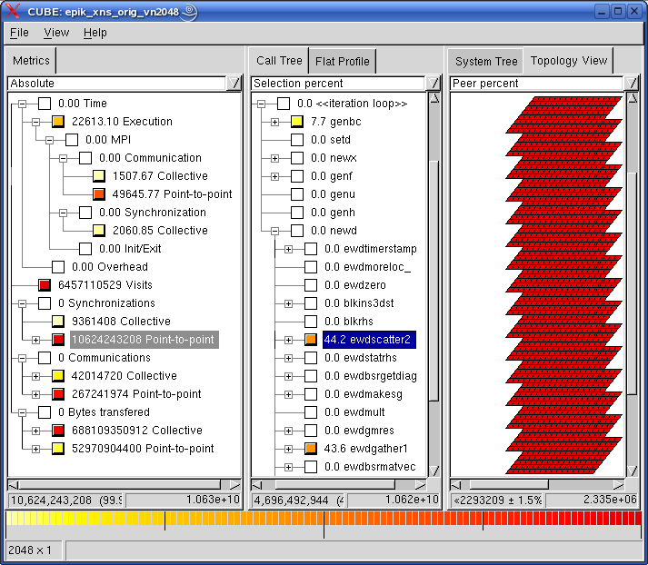
Callpath Profile: P2P Synchronization
Point-to-
point msgs
w/o data
Masses of
P2P sync. operations
Processes
all equally
responsible

Slide 65
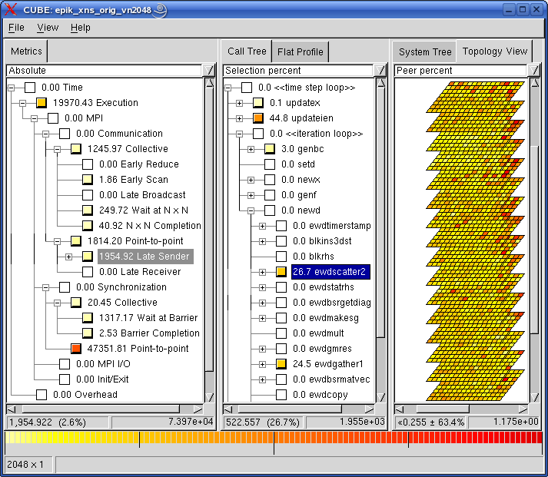
Trace Analysis: Late Sender
Wait time
of receivers
blocked for
late sender
Half of the send time
is waiting
Significant
process
imbalance

Slide 66
Scalasca Approach to Performance Dynamics
Overview
Capture overview of performance dynamics via time-series profiling
Focus
Identify pivotal iterations - if reproducible
In-depth analysis
In-depth analysis of these iterations via tracing
Time and count-based metrics
Analysis of wait-state formation
Tracing restricted to iterations of interest
Critical-path analysis
New

Slide 67
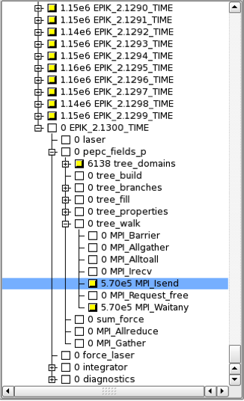
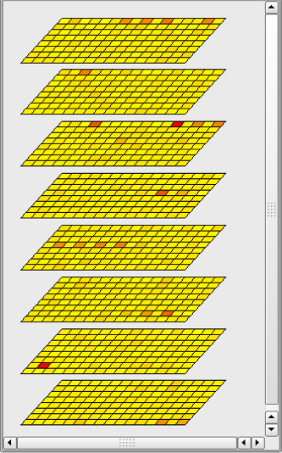
Time-series Callpath Profiling
Instrument main loop to distinguish individual iterations
Complete call tree with multiple metrics recorded for each iteration
Challenge: storage requirements proportional to #iterations
#include "epik_user.h"
void initialize() {}
void read_input() {}
void do_work() {}
void do_additional_work() {}
void finish iteration() {}
void write_output() {}
int main() {
int iter;
PHASE_REGISTER(iter,”ITER”);
int t;
initialize();
read_input();
for(t=0; t<5; t++) {
PHASE_START(iter);
do_work();
do_additional_work();
finish_iteration();
PHASE_END(iter);
}
write_output();
return 0;
}
Call tree
Process topology

